Slide 1
Source-to-Source Automatic Transformation To Tail Recursion
Harshil Vagadia Advisor - Prof. S. Arun-Kumar

Slide 2
Classification of Function Declaration
All the functions can be classified into one of the following four classes:
Non Recursive - The body of the function do not contain any call to the same function.
Recursive - The body of the function contains one or more calls to the same function.
Mutually Recursive - The body of the function contains one or more calls to another Mutually Recursive function. There is a cyclic dependency among function calls.
Tail Recursive - The body of the function is a function call to the the same function with different arguments. The arguments should not contain any call to the same function.

Slide 3


Examples
Recursive:
Tail Recursive:
Here z represents zero and s(x) represents x+1

Slide 4
Advantages of Tail Recursion
In a normal recursive function, each call to the function accumulates in the runtime stack. This results in a large space consumption over large inputs.
Tail recursive functions does not build into a stack. Whenever a parent call executes a child call, the parent call can be discarded as the child call is the last computation for the function.
Tail recursive functions can be easily reduced to iterative functions. Thus tail recursion serves as an intermediate in recursive function to iterative function conversion.

Slide 5
Problem Statement
Given a SML program containing some values and function declaration, convert it to another SML program where all the Recursive function declaration are Tail Recursive. The semantics of the input program should be unchanged i.e both the input and output program should yield identical results under identical inputs. Input - A SML file (say inp.sml) containing code written in subset of SML language (called mini-SML, which is defined later). The input file should be executable in a SML environment and should be sufficiently complete to incorporate basic programming functions. Output - A SML file (say out.sml) containing transformed code. All the functions in the output file should be Non Recursive or Tail Recursive. The output file should also be executable in SML environment.

Slide 6
Project Pipeline
Define the language mini-SML using EBNF specification and convert it to LALR(1) parsable grammer.
Create a lexer and a parser based on the grammer to generate Abstract Syntax Trees (ASTs) from the input file.
Classify various functions in the input file into Non Recursive, Recursive, Tail Recursive and Mutually Recursive.
Convert Recursive and Mutually Recursive into Tail Recursive functions using an automated algorithm.
Output the converted functions with suitable localisation to expose only the original function signature to the main environment.
Test the conversion on various Recursive and Mutually Recursive Functions.
Compare the running time of original and converted programs.

Slide 7
EBNF for mini-SML
Program ::= DatatypeDeclaration FunctionDeclarationList.
DatatypeDeclaration ::= "datatype" DatatypeDefinition {"and" DatatypeDefinition}.
FunctionDeclarationList ::= {FunctionDeclaration}.
FunctionDeclaration ::= "fun" Function {"and" function}.
DatatypeDefinition ::= Identifier "=" Constructor {"|" Constructor}.
Constructor ::= Identifier | Identifier "of" Type.
Type ::= Identifier {"*" Identifier}.
Function ::= Rewrite {"|" Rewrite}.
Rewrite ::= Identifier "(" Arguments ")" "=" ConstructorExpression.
Arguments ::= ConstructorExpression {"," ConstructorExpression}.
ConstructorExpression ::= Identifier "(" Arguments ")" [":" Type] | Identifier [":" Type].
Note: The current grammar supports only Constructor Expressions. The support for integers, booleans and various operations like arithmetic operation, boolean operations, if then else etc. can be added as described in later section.

Slide 8
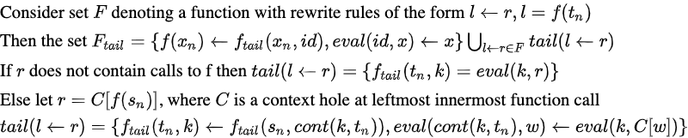
Algorithm for Automatic Conversion

Slide 9
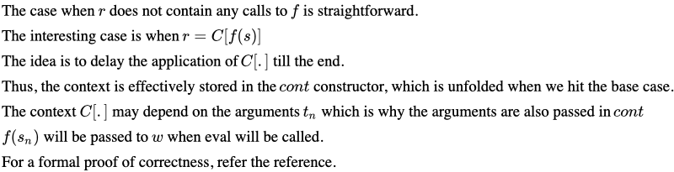
Correctness

Slide 10
Sample Conversion - Input
datatype num = Zero | Successor of num
fun fib(Zero) = Zero
| fib(Successor(Zero)) = Successor(Zero)
| fib(Successor(Successor(n))) = add(fib(n), fib(Successor(n)))

Slide 11
Sample Conversion - Output
datatype num = Zero | Successor of num
local
datatype acc_fib = Id_fib | Cont_fib of acc_fib * num
fun fib_tail (Zero, k) = eval_fib(k, Zero)
| fib_tail (Successor(Zero), k) = eval_fib(k, Successor(Zero))
| fib_tail (Successor(Successor(n)), k) = fib_tail(n, Cont_fib(k, Successor(Successor(n))))
and eval_fib (Id_fib, x) = x
| eval_fib (Cont_fib(k, Successor(Successor(n))), w) = eval_fib (k, add(w, fib_tail(Successor(n), Id_fib)))
in
fun fib (x_0) = fib_tail (x_0, Id_fib)
end

Slide 12
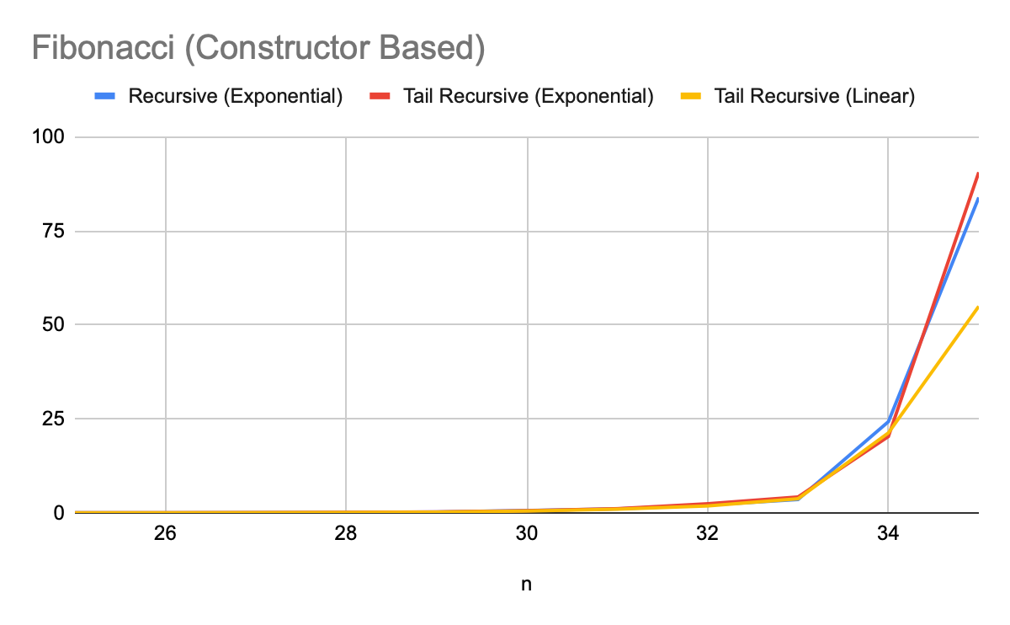
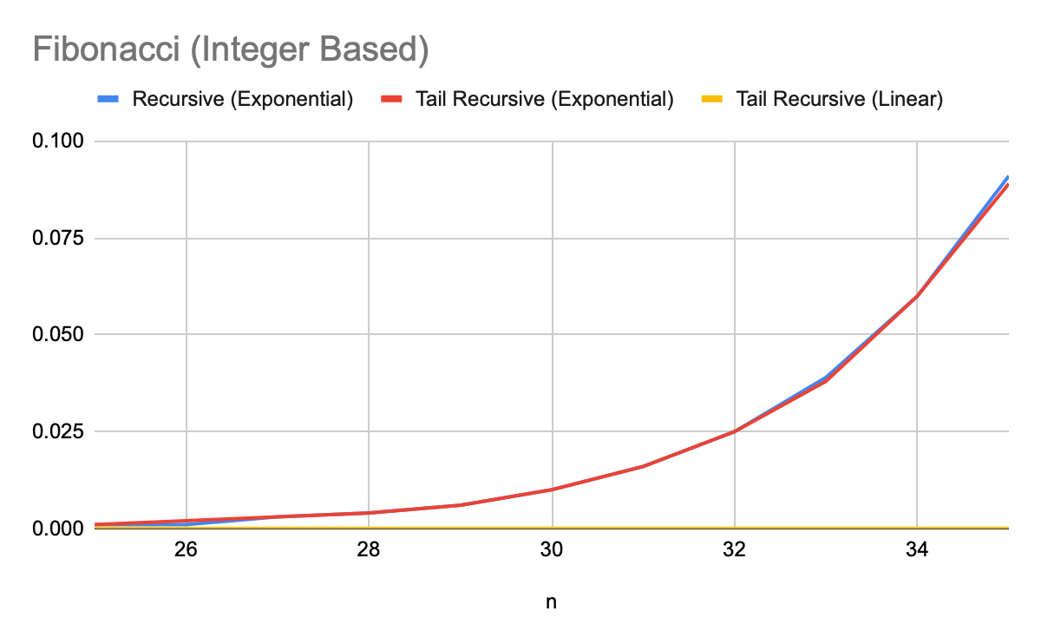
Execution Time
The runtime of previously described Fibonacci functions (recursive and tail recursive) functions are compared below. Both constructor based and numerical versions are compared. A O(n) tail recursive algorithm is also included to provide the most efficient benchmark.
Tail Recursive functions matches the normal implementation in both cases, even though it has more constructor calls (due to the eval calls).

Slide 13
Support for Integer Functions
The current pattern matching based algorithm would not work when using integers. For example, conditions like a < 0, cannot be evaluated via pattern matching, and vica versa.
Hence, we need support for if then else construct in the grammar. The transformation algorithm then becomes:
is transformed to

Slide 14
Updated EBNF
Extending the earlier EBNF, all the instances of ConstructorExpression should be replaced by Expression, which is defined as follows:
Expression ::= Num [":" Type] | Bool [":" Type]
| Expression Binop Expression | Unop Expression
| "(" Expression ")"
| "if" Expression "then" Expression "else" Expression
| Identifier "(" Arguments ")" [":" Type] | Identifier [":" Type].
Binop ::= "+" | "-" | "*" | "/" | "=" | "<" | ">" | "andalso" | "orelse" | "^".
Unop ::= "~" | "not".

Slide 15
Sample Conversion
fun fact (n) = if n = 0 then 1 else n * fact (n - 1)
local
datatype acc_fact = Id_fact | Cont_fact of acc_fact * (int)
fun fact_tail (n, k) = if (n=0) then eval_fact(k, 1) else fact_tail((n-1), Cont_fact(k, n))
and eval_fact (Id_fact, x) = x
| eval_fact (Cont_fact(k, n), w) = eval_fact (k, if (n=0) then 1 else (n*w))
in
fun fact (x_0) = fact_tail (x_0, Id_fact)
end

Slide 16
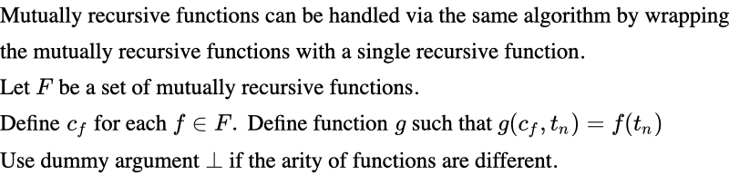
Mutually Recursive Functions

Slide 17
References
Thank You
Conversion to tail recursion in term rewriting (https://doi.org/10.1016/j.jlap.2013.07.001)

